Slide 1
Capstone Project - The Battle of Neighborhoods
Exploring Montreal’s Food Diversity
(Week 2)

Slide 2
Introduction and Business Description
Problem Background
  Montreal needs no introduction, nor its ethnically diverse groups.
  Full of diverse entertainment activities (including Jazz festival) which are a part of supply chain lines on the hotels and restaurants.
  More than one in every ten Canadians lives in the Montreal Metropolitan
  https://canadapopulation.org/montreal-population/#Montreal_Metropopulation
The Problem
  To get a descriptive picture of food diversity in Montreal and its neighborhoods, and understand the associated factors.

Slide 3
Introduction and Business Description (continued)
Target Audience
  Entrepreneurs who could be a start-up for opening a normal restaurant, a restaurant with specialty or in supply chain
Success Criteria
  The identified venues with restaurants representing diverse foods and clusters of venues associated with specialty foods.
  Links to the visuals:
      https://www.tripsavvy.com/montreal-restaurants-4139153
      https://www.tripsavvy.com/montreal-4139156

Slide 4
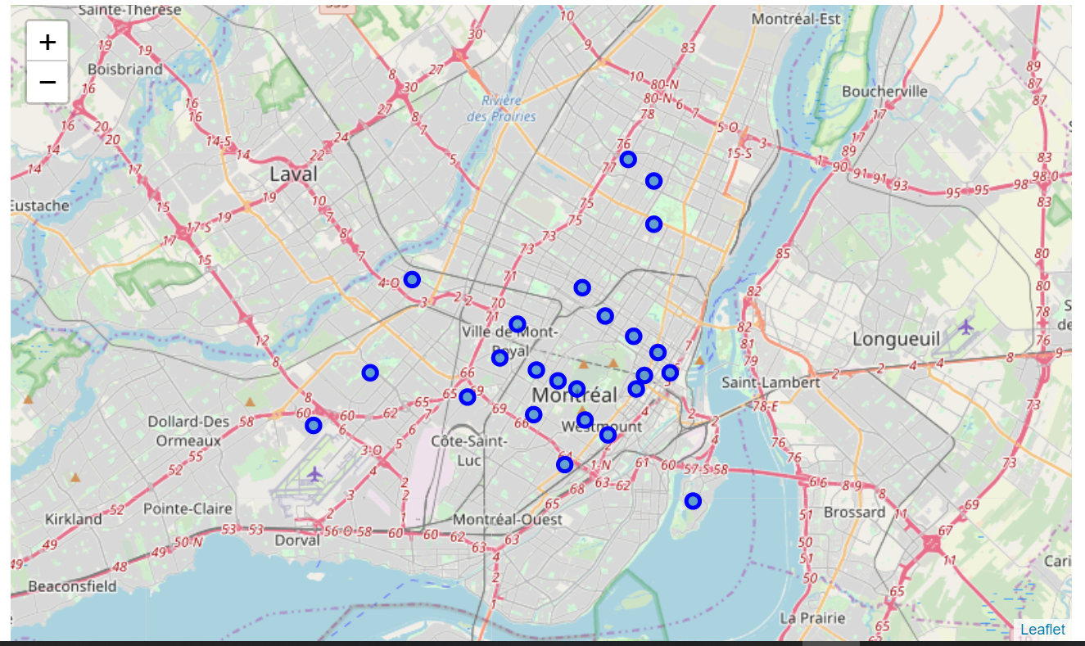
Data Harvesting
  Link: https://www.geonames.org/postal-codes/CA/QC/quebec.html
  The above contains the information on the Canadian postal code, place, its longitude and latitude, Admin2 and others.
  Html parser and BeautifulSoul, pandas to scrape and bring to a cleaned dataframe
            Map of Montreal neighborhoods

Slide 5
Results
When explored within 500 m radius circle and 100 (at the limit) venues were returned by the Foursquare and there were 174 unique categories.
The type of business (venue) was found not independent of the neighborhood. This indicates a point in examining neighborhood-wise.
However, based on overall the neighborhoods, the ten most frequent venues were:
  "Cafe', Hotel, French restaurant, Bar and Coffee Shop", Park, Restaurant, Pizza Place, Bakery, Clothing Store"
  Cafe' and Coffee Shop are within top ten; entrepreneur may look for general coffee places as well as specialty coffee
  French Restaurant and Restaurant appear in top ten, shows the popularity of specialty restaurants.
  Cafe is number 1 and Hotel is 2 which is easy to understand considering the nature of Montreal.

Slide 6
Results (continued)
  In specific neighborhoods, the frequency and popularity/commonality of venues varied.
  For instant, the five most frequent venues/businesses were:
    Burger Joint (0.17), Metro Station (0.17), Café (0.17), French Restaurant (0.17), Pharmacy (0.17) in Côte-des-Neiges East neighborhood
    Flower Shop (0.25), Portuguese Restaurant (0.25), Sushi Restaurant (0.25), Park (0.25), Pastry Shop in Côte-des-Neiges North,
    Portuguese Restaurant in Côte-des-Neiges North
    Italian Restaurant in Downtown Montreal South & West
    Hotel, coffee shops and clothing venues in Downtown Montreal East
    among others.
  The identification strength of a venue – neighborhood varied with the area explored by setting a different radius. However, the most common venue in Montreal downtown neighborhoods are Café’ and hotels.
  The data strongly support narratives for food diversity in Montreal region. Among the foods of popularity, there is a strong diversity in the specialty restaurants such those with as French, Japanese (Shushi), Portuguese, English, Mediterranean, Spanish, Chinese, Indian, Sri Lankan, Vietnamese, Filipino cuisines among others.

Slide 7
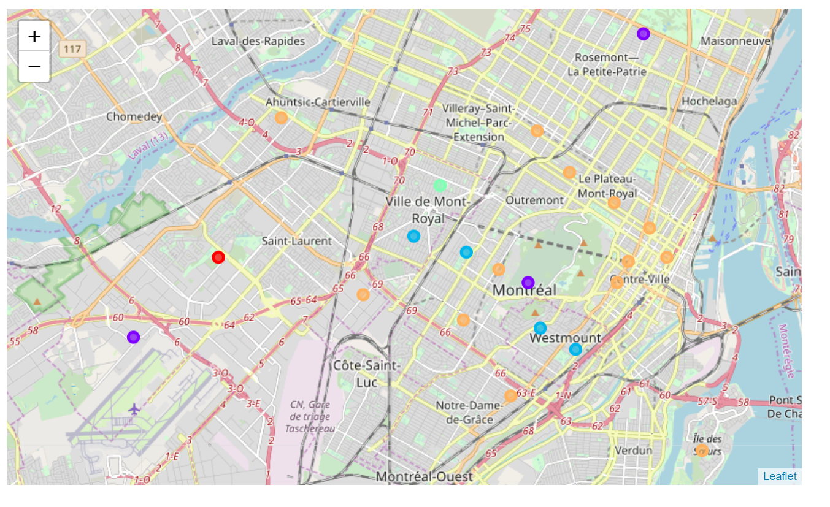
Results (continued)
Clustering of neighborhoods
  The 5 clusters found were:
      Cluster 1: Saint-Laurent Southeast (1 neighborhood)
      Cluster 2: Côte-des-Neiges Southwest (3 neighborhoods)
      Cluster 3: Côte-des-Neiges Northeast (4 neighborhoods)
      Cluster 4: Mount Royal Central (1 neighborhood)
      Cluster 5: Montreal Downtown (16 neighborhoods)
  Map 2. Clustering of neighborhoods in Montreal area

Slide 8
Recommendations and Future Look-ups
Investors may consider further enhancing the food diversity in the specialty restaurants such as French, Japanese (Shushi), Portuguese, English, Mediterranean, Spanish, Chinese, Indian, Sri Lankan, Vietnamese, Filipino cuisines among others.
The employment and economic scenarios need to be studied.

